Slide 1
What, Why, how hpc in csc
Notes:
University of Helsinki researchers:
Mirkka Sarparanta, Academy Research Fellow, Department of Chemistry Subunit
Tracers in Molecular Imaging (TRIM)
Jose Filipe Silva, Associate professor, Department of Philosophy, History and Art Studies

Slide 2
Today’s topics
What, Why, and How high-performance computing (HPC)?
CSC and its services
Hands-on:
Log-in to Puhti
Set up SSH Key Pair to Puhti
Clone https://github.com/Saukkoriipi/SDA-HPC-TRAINING from GitHub to Puhti
Run Python CPU program
Run Python GPU program

Slide 3
WHY to use supercomputerS?
Large-scale simulations
Problems with large datasets
Complex computational problems
Use cases that are very time-consuming or even impossible to solve on a standard computer

Slide 4
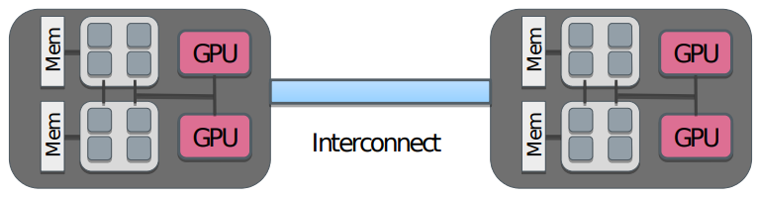
What is A SUPERcomputER?
Computer with computing power much larger than what is available in a typical desktop computer.
Supercomputers consist of nodes connected by a high-speed network
Latency ~1 µs, bandwidth ~20 GB / s
A node can contain several multicore CPU’s
Additionally, a node can contain one or more accelerators

Slide 5
What is A SUPERcomputER?
Benefits from the user perspective:
More main memory
More RAM
More powerful CPUs and GPUs
Biggest benefits are achieved when multiple CPUs and GPUs are used
Requires parallelization
More later

Slide 6
What is A SUPERcomputER?
A concrete example from CSC Mahti supercomputer node structure
1404 CPU nodes. Each node has:
2x AMD Rome 7H12 CPUs (64 cores)
24 GPU nodes. Each node has:
2x AMD Rome 7H12 CPUs (64 cores)
4x Nvidia Ampera A100 GPUs ($32,000/pcs).

Slide 7
Parallel processing
Modern (super)computers rely on parallel processing
Multiple CPU cores & accelerators (GPUs)
World #1 system has ~9 000 000 cores and ~40 000 GP
Vectorization
A single instruction can process multiple data (SIMD)
Example: Summing two vectors takes the same time as summing two numbers
Pipelining
Core executes different part of instructions in parallel
More later

Slide 8
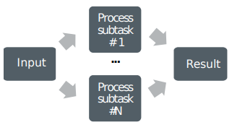
Parallel processing
Parallel computing
A problem is split into smaller subtasks
Multiple subtasks are processed simultaneously using multiple cores
Example: 1+2+3+4 can be calculated as (1+2) + (3+4)

Slide 9
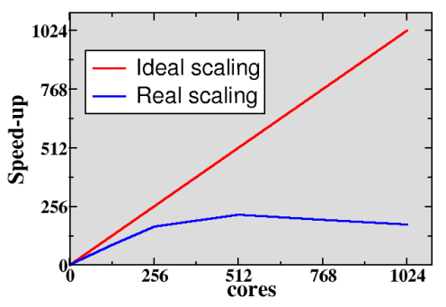
Parallel scaling
Strong parallel scaling
Constant problem size
Execution time decreases in proportion to the increase in the number of cores
Weak parallel scaling
Increasing problem size
Execution time remains constant when the number of cores increases in proportion to the problem size

Slide 10
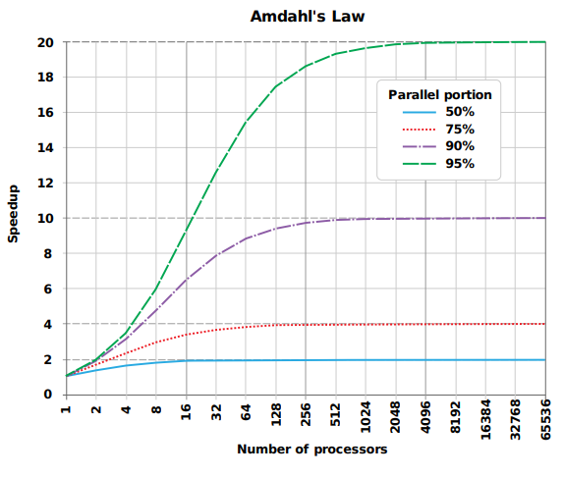
What limits parallel scaling
Load imbalance
Variation in workload over different cores
Execution time decreases in proportion to the increase in the number of cores
Parallel overheads
Additional operations which are not present in serial calculation
Synchronization, redundant computations, communications
Amdahl’s law: the fraction of non- parallelizable parts establishes the limit on how many cores can be harnessed

Slide 11
What limits parallel scaling
Deep learning example LSTM vs Transformer
Computing complexy (n=sequence length)
LSTM: O(n)
Transformer: O(n^2)
Parallelizability:
LSTM: Can not be parallelized at the sequence level
Transformer: easily parallelized at the sequence level
Result:
LSTMs are much slower to train than self-attention networks (Transformers)
Source: Multi-Head Highly Parallelized LSTM Decoder for Neural Machine Translation (2021)

Slide 12
Parallel programming languages
Standard HPC coding languages: C/C++ and Fortran
Higher-level languages like Python and Julia are gaining popularity
Often computationally intensive parts are still written in C/C++ or Fortran, like inside NumPy and Pytorch
Main tools to write highly parallel programs:
MPI: Message Passing Interface for parallel programming (multiple nodes/multiple CPUs/multiple GPUs)
OpenMP: library for parallel programming for shared-memory processors (multiple threads inside CPU)
CUDA: API to write programs for Nvidia GPU:s
HIP: API to write programs for AMD GPU:s
These tools are used inside applications like Pytorch and Tensorflow and they are mostly hidden from the user's perspective.
When developing something that ready-made parallelized applications do not support, and massive parallelization is needed, then these are the main building blocks.

Slide 13
CSC and its services
Notes:
University of Helsinki researchers:
Mirkka Sarparanta, Academy Research Fellow, Department of Chemistry Subunit
Tracers in Molecular Imaging (TRIM)
Jose Filipe Silva, Associate professor, Department of Philosophy, History and Art Studies

Slide 14
What is CSC
CSC is a non-profit state enterprise with special tasks.
“As part of the national research system, we develop, integrate, and provide high-quality information technology services and ensure that Finland remains at the forefront of development.”
We are owned by the Finnish state (70% shareholding) and higher education institutions (30% shareholding).
Primary customers:
Ministry of Education and Culture
Organizations in the field
Higher education institutions (universities and universities of applied sciences)
Research institutes
Public Administration

Slide 15
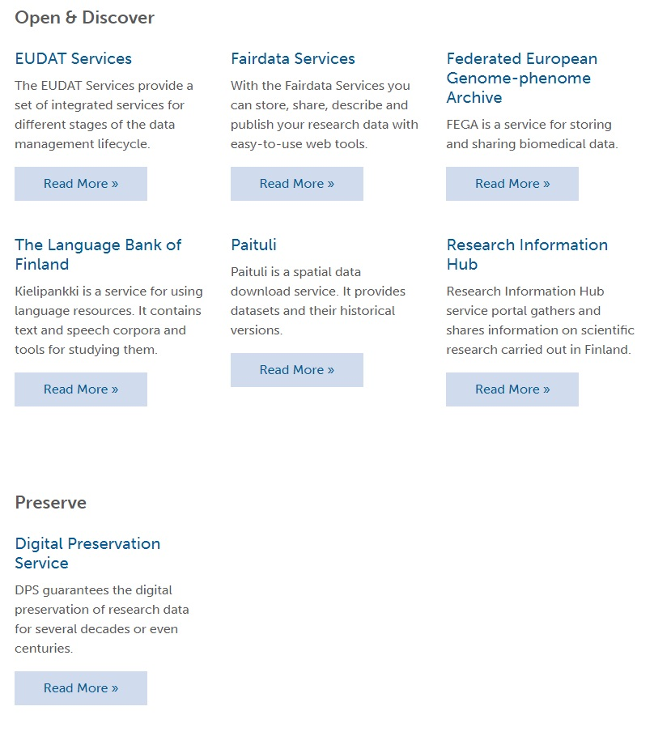
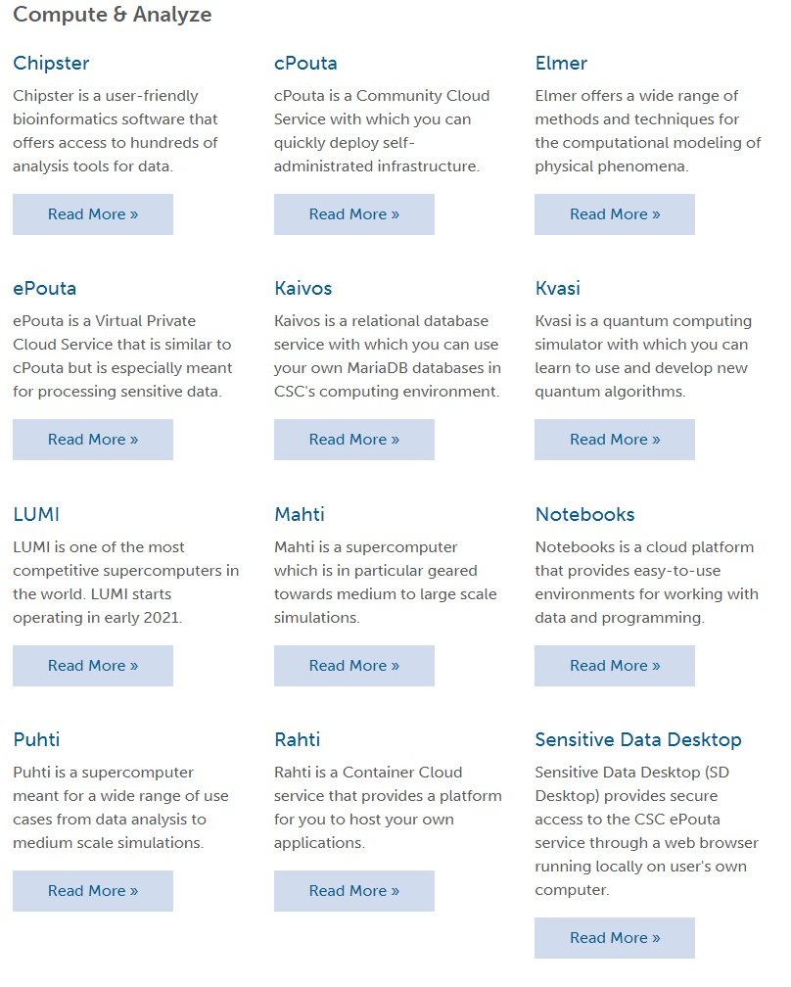
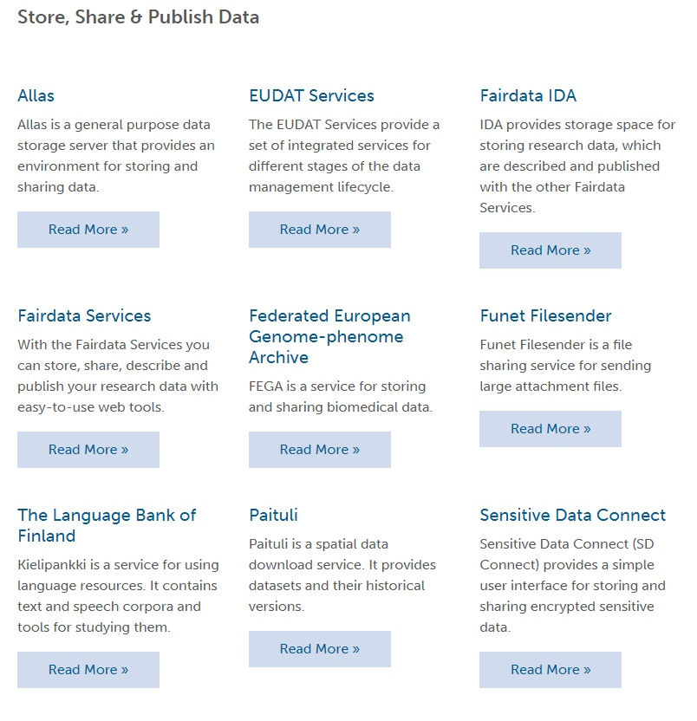
CSC Services

Slide 16
CSC supercomputing services
PUHTI
700 CPU nodes
CPU: 2x 20-core Intel
CPU MEM: 192GB-1.5TiB
80 GPU nodes
CPU: 2x 20-core Intel
CPU MEM: 384 GB
GPU: 4x Nvidia V100
GPU MEM: 4x 32GB
I/O speed: ~50GB/s (scratch)
For small to medium programs
MAHTI
1404 CPU nodes
CPU: 2x 64-core AMD
CPU MEM: 256 GB
24 GPU nodes
CPU: 2x 64-core AMD
CPU MEM: 512 GB
GPU: 4x Nvidia A100
GPU MEM: 512 GB
I/O speed: ~100GB/s (scratch)
For medium to large programs
LUMI-G (ready in X/2022)
GPU heavy computing
AMD GPUs

Slide 17
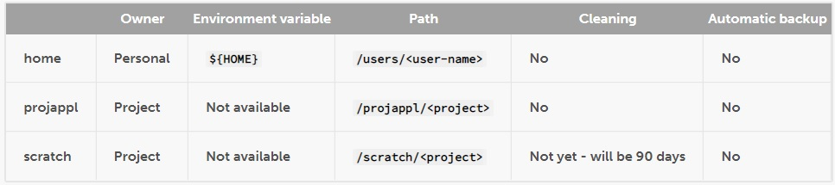
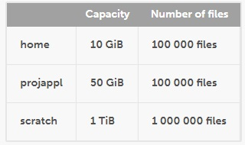
CSC supercomPUTERS DISK AREAS
CSC supercomputers have three main disk areas: home, projappl and scratch.
The disk areas for different supercomputers are separate, i.e. home, projappl and scratch in Puhti cannot be directly accessed from Mahti.
Home: Store configuration files and other minor personal data
Projappl: Store applications you have compiled yourself, libraries etc. that you are sharing within the project
Scratch: Fast parallel memory space for data analysis and computing
The scratch and projappl directories are shared by all the members of the project.

Slide 18
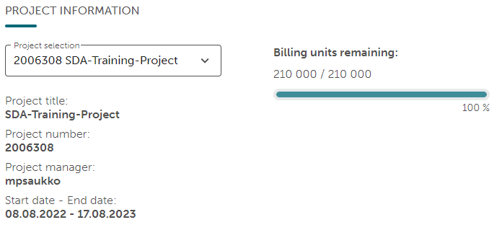
CSC Billing Units system
CSC services are not free
Using CSC services is paid with the Billing Units (BUs)
Person can not own CSC BUs, only projects
Researchers, teachers, and learners will get CSC BUs for free for their projects
When running code at the CSC supercomputer, you need to define which projects BUs you want to use

Slide 19
Csc supported applications
CSC supercomputers support 136 applications
Examples of supported applications:
ArcGIS General purpose GIS software family for viewing, editing and analysing geospatial data
Geoconda - Python spatial analysis libraries
JAX Autograd and XLA, brought together for high-performance machine learning
MATLAB High-level technical computing language
Python Data Collection of Python libraries for data analytics and machine learning
Python programming language and its modules at CSC.
PyTorch Machine learning framework for Python
QGIS General purpose GIS software family for viewing, editing and analysing geospatial data
RStudio Integrated development environment for R
TensorFlow Deep learning library for Python
All 136 supported applications and guides to starting using: docs.csc.fi/apps/

Slide 20
CSC module system
The module system enables managing several mutually incompatible software environments within one computer.
The environment modules provide a convenient way to set up everything required by a particular application.
The module system modifies the environment variables of the user's shell so that the correct versions of executables are in the path and the linker can find the correct version of the required libraries.
Example01 – User wants supercomputer with Pytorch 1.12: module load pytorch/1.12
Example02 - User wants supercomputer with Matlab2021b: module load matlab/r2021b
You can also create your own module environment with wanted programs and dependencies, but for most of the use cases, there is a ready-made module already available.

Slide 21
Csc batch job and queue
CSC uses a batch job system to execute computing tasks on our supercomputers.
When you log in to the Puhti, you do not reserve any CPUs or GPUs. This happens only after you run your program, which will be done as a batch job.
Typically, a batch job first loads a software environment using the module system and then executes a program to do some computing.
A batch job is also required to specify the resources needed for the execution of the job.
Batch jobs do not run instantly but are put in a queue
Required computing resources will affect queue time
To minimize the time in queue, reserve only the amount of the resources you really need!
Billing is based on requested resources, not used resources!
The starting time for a job cannot be predicted

Slide 22
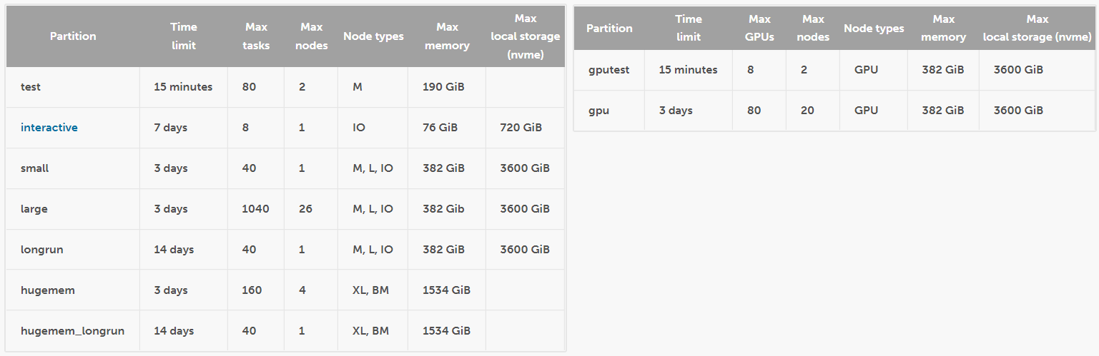
CSC puhti partitions

Slide 23
Example batch job script
#!/bin/bash
#SBATCH --job-name=bowtie2 << Name of your job. Used in the queue and when checking past jobs.
#SBATCH --account=project_2006308 << Project of which Billing Units you want to use for computing.
#SBATCH –partition=gputest << Partition you want to use.
#SBATCH --time=01:00:00 << Maximum time for the program to run. Will be terminated after this time.
#SBATCH --mem-per-cpu=16G << CPU memory
#SBATCH --gres=gpu:v100:1 << CPU reserve 1pcs Nvidia v100 GPU
#SBATCH --mail-type=BEGIN << Send me email when my batch job start running
module load pytorch/1.12 << Load Pytorch version 1.12
srun python3 lstm_pytorch.py << Execute “python3 lstm_pytorch.py”

Slide 24

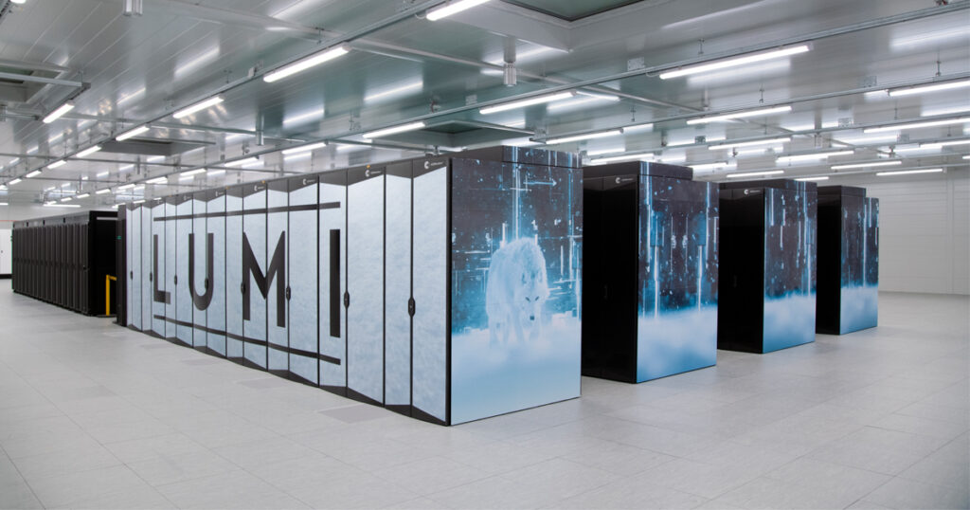





File transfers (my recommendation)
Blue = Data transferred via scp, FileZilla, WinSCP etc.
Green = Code transferred via GitHub remote repository

Slide 25
Visual studio code
https://docs.csc.fi/computing/webinterface/vscode/

Slide 26
Hands-on
Notes:
University of Helsinki researchers:
Mirkka Sarparanta, Academy Research Fellow, Department of Chemistry Subunit
Tracers in Molecular Imaging (TRIM)
Jose Filipe Silva, Associate professor, Department of Philosophy, History and Art Studies

Slide 27
Hands-on
Log-in to Puhti
Set up SSH Key Pair to Puhti
Create folder with your name to SDA scratch
Like: /scratch/project_2006308/mikko
Clone from Github to newly create folder: https://github.com/Saukkoriipi/SDA-HPC-TRAINING
Run Python CPU program: sbatch test_gpu_available.py
Run Python GPU program: sbatch test_gpu_available.py
Check results from files: cpu_speed.txt and gpu_speed.txt

